Slide 1
Data Pre-processing

Slide 2
Contents
Data Cleaning
Data Integration and Transformation
Data Reduction
Data discretization
Concept hierarchy generation

Slide 3
Data Pre-processing
Real-world databases are highly susceptible to noisy, missing, and inconsistent data due to their typically huge size (often several gigabytes or more) and their likely origin from multiple, heterogenous sources.
Low-quality data will lead to low-quality mining results.
How can the data be pre-processed in order to help improve the quality of the data and, consequently, of the mining results?
How can the data be pre-processed so as to improve the efficiency and ease of the mining process?

Slide 4
Data preprocessing techniques
Several data preprocessing techniques.
Data cleaning can be applied to remove noise and correct inconsistencies in data.
Data integration merges data from multiple sources into a coherent data store such as a data warehouse.
Data reduction can reduce data size by, for instance, aggregating, eliminating redundant features, or clustering.
Data transformations (e.g., normalization) may be applied, where data are scaled to fall within a smaller range like 0.0 to 1.0.
This can improve the accuracy and efficiency of mining algorithms involving distance measurements.
These techniques are not mutually exclusive; they may work together.
Eg: data cleaning can involve transformations to correct wrong data, such as by transforming all entries for a date field to a common format.

Slide 5
Data Quality
What kinds of data quality problems?
How can we detect problems with the data?
What can we do about these problems?
Examples of data quality problems:
Noise and outliers
Noise: random error or variance in a measured variable
Outliers are data objects with characteristics that are considerably different than most of the other data objects in the data set
Missing values
Duplicate data

Slide 6
Data Quality- Missing Values and Duplicate Data
Reasons for missing values
Information is not collected
(e.g., people decline to give their age and weight)
Attributes may not be applicable to all cases
(e.g., annual income is not applicable to children)
Handling missing values
Eliminate Data Objects
Estimate Missing Values
Ignore the Missing Value During Analysis
Replace with all possible values (weighted by their probabilities)
Data set may include data objects that are duplicates, or almost duplicates of one another
Major issue when merging data from heterogenous sources

Slide 7
Data Quality: Why Preprocess the Data?
Data have quality if they satisfy the requirements of the intended use.
Accuracy: correct or wrong, accurate or not
There are many possible reasons for inaccurate data.
Human or computer errors occurring at data entry.
Users may purposely submit incorrect data values for mandatory fields when they do not wish to submit personal information such as choosing the default value “January 1” displayed for birthday.
Incorrect data may also result from inconsistencies in naming conventions or data codes, or inconsistent formats for input fields (e.g., date).
Completeness: not recorded, unavailable, …
Attributes of interest may not always be available
Data may not be included simply because they were not considered important at the time of entry.
Relevant data may not be recorded due to a misunderstanding.
Missing data, tuples with missing values for some attributes, may need to be inferred.

Slide 8
Data Quality: Why Preprocess the Data?
Consistency: some modified but some not, dangling, …
Inconsistencies in data codes, or inconsistent formats for input fields (e.g., date).
Eg: discrepancies in the department codes used to categorize items.
Timeliness: timely update?
Is the data is timely updated?
Believability: how trustable is the data? Is it correct?
How much the data are trusted by users?
The past errors can effect the trustability of the data.
Interpretability: how easily the data can be understood?

Slide 9
Major Tasks in Data Preprocessing
Data cleaning can be applied to remove noise and correct inconsistencies in the data.
Fill in missing values, smooth noisy data, identify or remove outliers, and resolve inconsistencies
Data integration merges data from multiple sources into a coherent data store, such as a data warehouse.
Integration of multiple databases, data cubes, or files.
Data transformations - Data are scaled to fall within a smaller range like 0.0 to 1.0.
Normalization , Data Discretization and Concept hierarchy generation are forms of data transformations.
For example, normalization may improve the accuracy and efficiency of mining algorithms involving distance measurements.
Data reduction obtains a reduced representation of the data set that is much smaller in volume, yet produces the same (or almost the same) analytical results.
Can reduce the data size by aggregating, eliminating redundant features, or clustering.
Data aggregation, Attribute subset selection, Dimensionality reduction, Numerosity reduction, Data compression, by generalization with the use of Concept hierarchy
Data Discretization- a form of data reduction that is very useful for the automatic generation of concept hierarchies from numerical data.

Slide 10
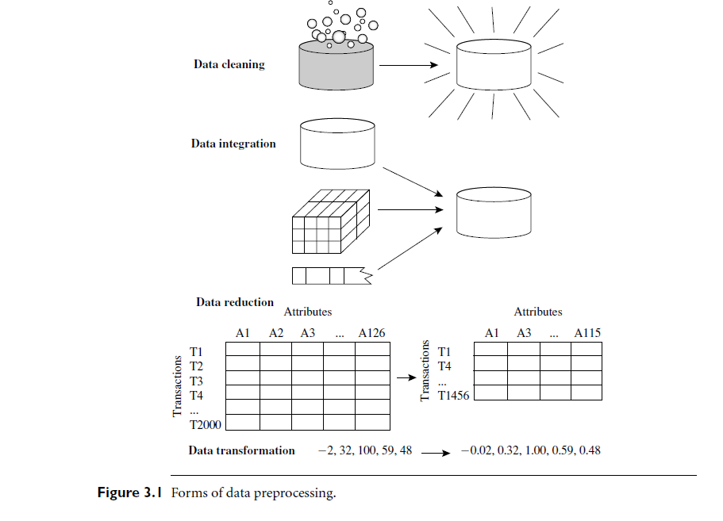

Slide 11
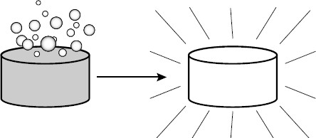
Data Cleaning
Data cleaning routines work to “clean” the data by filling in missing values, smoothing noisy data, identifying or removing outliers, and resolving inconsistencies.

Slide 12
How to Handle Missing Data?
Ignore the tuple: Usually done when the class label is missing (assuming the mining task involves classification).
Not very effective, unless the tuple contains several attributes with missing values.
Poor when the percentage of missing values per attribute varies considerably.
By ignoring the tuple, we do not make use of the remaining attributes’ values in the tuple which could have been useful to the task at hand.
Fill in the missing value manually: Time consuming and may not be feasible given a large data set with many missing values.
Use a global constant to fill in the missing value: Replace all missing attribute values by the same constant such as a label like “Unknown” or -∞.
If missing values are replaced by, say, “Unknown,” then the mining program may mistakenly think that they form an interesting concept, since they all have a value in common—that of “Unknown.”
This method is simple, it is not foolproof.

Slide 13
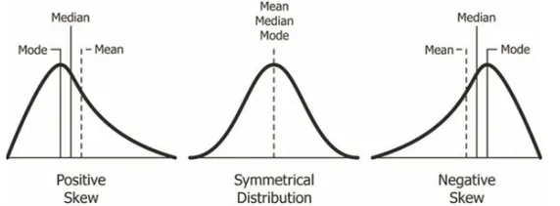
How to Handle Missing Data?
Use a measure of central tendency for the attribute to fill in the missing value:
For e.g., the mean or median- normal (symmetric) data distributions, the mean can be used, while skewed data distribution should employ the median.
For example, suppose that the data distribution regarding the income of AllElectronics customers is symmetric and that the mean income is $56,000. Use this value to replace the missing value for income.
Use the attribute mean or median for all samples belonging to the same class as the given tuple:
For example, if classifying customers according to credit risk, we may replace the missing value with the mean income value for customers in the same credit risk category as that of the given tuple. If the data distribution for a given class is skewed, the median value is a better choice.
Use the most probable value to fill in the missing value:
Determined with regression, inference-based tools using a Bayesian formalism, or decision tree induction.
For example, using the other customer attributes in your data set, you may construct a decision tree to predict the missing values for income.
Notes:
Skewed data distribution refers to a situation in a dataset where the values are not symmetrically distributed around the mean. Instead, the data tends to have a longer tail on one side of the distribution than the other.

Slide 14
Noisy Data and
How to Handle Noisy Data?
Noise: random error or variance in a measured variable
Outliers may represent noise.
Given a numeric attribute such as, say, price, how can we “smooth” out the data to remove the noise?
Data Smoothing Techniques:
Binning
Regression
Clustering
Combined computer and human inspection

Slide 15
Noisy Data and
How to Handle Noisy Data?
Data Smoothing Techniques:
Binning
smooth a sorted data value by consulting its “neighborhood,” that is, the values around it.
sorted values are distributed into a number of “buckets,” or bins.
Because binning methods consult the neighborhood of values, they perform local smoothing.
First sort data and partition into (equal-frequency) bins
Then one can smooth by bin mean, smooth by bin median, smooth by bin boundaries, etc.

Slide 16
Binning Methods for Data Smoothing
Binning methods smooth a sorted data by distributing them into bins (buckets).
Smoothing by bin means:
Each value in a bin is replaced by the mean value of the bin.
Smoothing by bin medians:
Each bin value is replaced by the bin median.
Smoothing by bin boundaries:
The minimum and maximum values in a given bin are identified as the bin
boundaries.
Each bin value is then replaced by the closest boundary value.

Slide 17
Binning Methods for Data Smoothing: Example
Sorted data for price (in dollars): 4, 8, 15, 21, 21, 24, 25, 28, 34
Partition into (equal-frequency) bins:
– Bin 1: 4, 8, 15
– Bin 2: 21, 21, 24
– Bin 3: 25, 28, 34
Smoothing by bin means:
– Bin 1: 9, 9, 9
– Bin 2: 22, 22, 22
– Bin 3: 29, 29, 29
Smoothing by bin medians:
– Bin 1: 8, 8, 8
– Bin 2: 21, 21, 21
– Bin 3: 28, 28, 28
Smoothing by bin boundaries:
– Bin 1: 4, 4, 15
– Bin 2: 21, 21, 24
– Bin 3: 25, 25, 34

Slide 18
Noisy Data and
How to Handle Noisy Data?
Data Smoothing Techniques:.
Regression
Smooth by fitting the data into regression functions
A technique that conforms data values to a function.
Linear regression involves finding the “best” line to fit two attributes (or variables) so that one attribute can be used to predict the other.
Multiple linear regression
An extension of linear regression.
More than two attributes are involved and the data are fit to a multidimensional surface.
Clustering
Similar values are organized into groups, or “clusters”.
detect and remove outliers
values that fall outside of the set of clusters may be considered outliers
Combined computer and human inspection
detect suspicious values and check by human (e.g., deal with possible outliers)

Slide 19
Regression
Fit data to a function
Linear Regression – finding the best line to fit 2 attributes
y
Y1
Y1’
y = x + 1
X1
x

Slide 20
Cluster Analysis
Outliers may be detected
Similar values are organized into groups

Slide 21
Data Smoothing
Many methods for data smoothing are also methods for data reduction involving
discretization.
Eg1: The binning techniques reduce the number of distinct values per attribute.
This acts as a form of data reduction for logic-based data mining methods, such as decision tree induction, which repeatedly make value comparisons on sorted data.
Eg2: Concept hierarchies are a form of data discretization that can also be used for data smoothing.
A concept hierarchy for price, for example, may map real price values into inexpensive, moderately priced, and expensive, thereby reducing the number of data values to be handled by the mining process.

Slide 22
Data Cleaning as a Process
Data discrepancy detection
Discrepancies can be caused by
Poorly designed data entry forms that have many optional fields
Human error in data entry
Deliberate errors (e.g., respondents not wanting to divulge information about themselves)
Data decay (e.g., outdated addresses).
Inconsistent data representations and inconsistent use of codes.
(e.g., “2010/12/25” and “25/12/2010” for date).
Field overloading -Developers squeeze new attribute definitions into unused (bit) portions of already defined attributes.
Errors in instrumentation devices that record data and system errors.
When the data are (inadequately) used for purposes other than originally intended.
Inconsistencies due to data integration (e.g., where a given attribute can have different names in different databases)

Slide 23
Data Cleaning as a Process
Step 1: Data discrepancy detection
Use metadata-Knowledge regarding properties of the data
(e.g., domain and datatype, range, dependency b/w attr., distribution)
For example, values that are more than two standard deviations away from the mean for a given attribute may be flagged as potential outliers.
Check data regarding uniqueness rule, consecutive rule and null rule
Unique rule - Each value of the given attribute must be different from all other values for that attribute.
Consecutive rule - There can be no missing values between the lowest and highest values for the attribute, and that all values must also be unique (e.g., as in check numbers).
Null rule - specifies the use of blanks, question marks, special characters, or other strings that may indicate the null condition (e.g., where a value for a given attribute is not available), and how such values should be handled.

Slide 24
Data Cleaning as a Process
Data discrepancy Correction
Use commercial tools
Data scrubbing: use simple domain knowledge (e.g., postal code, spell-check) to detect errors and make corrections
Data auditing: by analyzing data to discover rules and relationship to detect data that violate such conditions (e.g., correlation and clustering to find outliers)
Data inconsistencies may be corrected manually using external references.
For example, errors made at data entry may be corrected by performing a paper traces.

Slide 25
Data Cleaning as a Process
Step 2: Data Transformation
Data migration and integration
Data migration tools: allow simple transformations to be specified Eg. Replacing ‘gender’ by ‘sex’.
ETL (Extraction/Transformation/Loading) tools: allow users to specify transformations through a graphical user interface.
Support only a restricted set of transforms.
Integration of the two processes
2 step process is error prone and time consuming.
Transformations may introduce more errors. (Eg. A typo ‘20004’ in a year field may only surface when all the date values are converted to a uniform formats)
Interactivity increased using
New data cleaning tools (e.g., Potter’s Wheels)-publicly available data cleaning tool- integrates discrepancy detection and transformation.
Using declarative language to specify data transformation operators.

Slide 26
Data Quality and Major Tasks in Data Preprocessing
Data Cleaning
Data Integration
Data Transformation
Data Reduction
Data Discretization

Slide 27
Data Integration
Data integration:
Combines data from multiple sources into a coherent store
Issues in integration
Schema integration and object matching can be tricky
Integrate data from different sources
Result- Entity identification problem
Eg: customer_id in one database and cust _number in another.
Detection and resolution of data value conflicts
For the same real world entity, attribute values from different sources are different Eg. Pay_type in one database be “H” and “S” and “1” and “2” in another
Possible reasons for conflicts: different representations, different scales, e.g., Weight stored in different units
Redundancy
Duplicate tuples
Denormalized tables

Slide 28
Handling Redundancy in Data Integration
Redundancy is another important issue in data integration.
An attribute may be redundant if it can be “derived” from another attribute or set of attributes.
Inconsistencies in attribute or dimension naming can also cause redundancies in the
resulting data set after data integration.
Redundant data occur often after integration of multiple databases
Object identification: The same attribute or object may have different names in different databases.
Derivable data: One attribute may be a “derived” attribute in another table, e.g., annual
revenue.
Careful integration of the data from multiple sources may help reduce/avoid redundancies and inconsistencies and improve mining speed and quality.
Redundant attributes may be able to be detected by correlation analysis.
χ² (chi-square) test for nominal attributes.
correlation coefficient and covariance for numeric attributes

Slide 29
Correlation Analysis (Numerical Data)
For numeric attributes, we can evaluate the correlation between two attributes, A and B, by computing the correlation coefficient(also called Pearson’s product moment coefficient).
where n is the number of tuples, and are the respective means of A and B, σ_{A} and σ_{B} are the respective standard deviation of A and B, and Σ(AB) is the sum of the AB cross-product.
Note that -1 ≤ r_{A,B} ≤ 1
If r_{A,B} > 0 : A and B are positively correlated (A’s values increase as B’s).
The higher, the stronger correlation.
r_{A,B} = 0: independent;
r_{A,B} < 0: negatively correlated (A’s values increase as B’s decreases-one discourages the other).

Slide 30




Correlation Analysis (for Numeric Data)
Covariance
The mean values of A and B, are also known as the expected values on A and B.
The covariance between A and B is defined as:
Covariance is similar to correlation coefficient:
It can also be shown that:
– This equation simplifies the calculation of Cov(A,B).

Slide 31
Covariance: Example
Suppose two stocks A and B have the following values in one week:
(2, 5), (3, 8), (5, 10), (4, 11), (7, 14).
Question: If the stocks are affected by the same industry trends, will their prices rise or fall together?
– E(A) = (2 + 3 + 5 + 4 + 7)/ 5 = 21/5 = 4.2
– E(B) = (5 + 8 + 10 + 11 + 14) /5 = 48/5 = 9.6
– Cov(A,B) = (2×5+3×8+5×10+4×11+7×14)/5 − 4.2 × 9.6 = 4.88
Thus, A and B rise together since Cov(A, B) > 0.

Slide 32


Correlation Test (for Nominal Data)
_{χ}2
(Chi-Square) Test
For nominal data, a correlation relationship between two attributes, A and B, can be
discovered by a χ² (chi-square) test.
Suppose A has c distinct values, a₁ … a_{c}. B has r distinct values, b₁ … b_{r}.
χ² (chi-square) Test:
where o_{ij} is the observed frequency (i.e., actual count) of the joint event (A_{i},B_{j}) and e_{ij} is the
expected frequency of (A_{i},B_{j}), which can be computed as
where n is the number of data tuples, count(A=a_{i}) is the number of tuples having value a_{i} for A, and count(B = b_{j}) is the number of tuples having value b_{j} for B.
The larger the χ² value, the more likely the variables are related.
– The cells that contribute the most to the χ² value are those whose actual count is very different from the expected count.
Notes:
Nominal data are used to label variables without any quantitative value.
Common examples include male/female, hair color, nationalities, names of people, and so on.

Slide 33
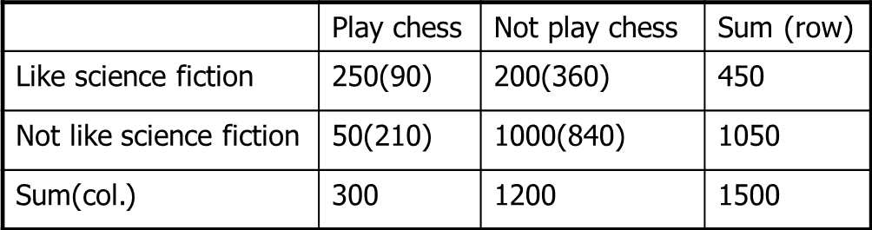
Chi-Square Calculation: An Example
Contingency Table for two attributes LikeScienceFiction and PlayChess
Numbers in cells are observed frequencies (numbers in parenthesis are expected
counts calculated based on the data distribution in the two categories).
e_{LSF,PC} = count(LSF)*count(PC) / n = 300*450 / 1500 = 90
χ² (chi-square) calculation
_{χ 2 =} (250 − 90)² ₊ (50 − 210)² ₊ (200 − 360)² ₊ (1000 − 840)²
90 210 360 840
= 507.93
Notes:
Contingency table: How many times the joint event (Ai, Bj), “attribute A takes on values ai and attribute B takes on value bj”, happens based on the observed data tuples.

Slide 34
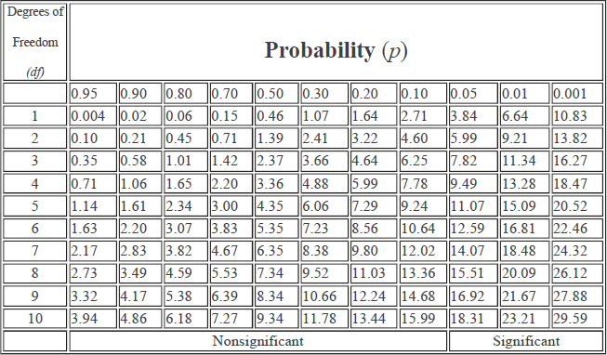
Chi-Square Calculation: An Example
For this 2x2 table, the degrees of freedom are (2-1)(2-1) = 1.
– There are two possible values for LikeScienceFiction attribute and two possible values for
PlayChess attribute.
For 1 degree of freedom, the χ² value needed to reject the hypothesis at the 0.001 significance level is 10.83 (from table of upper percentage points of χ² distribution).
Since our computed value
507.93 is above 10.83, we can reject the hypothesis that LikeScienceFiction and PlayChess are independent and conclude that the two attributes are (strongly) correlated for the given group of people.

Slide 35
Data Quality and Major Tasks in Data Preprocessing
Data Cleaning
Data Integration
Data Transformation
Data Reduction
Data Discretization

Slide 36
Data Transformation
In data transformation, the data are transformed or consolidated into forms
appropriate for mining.
In data transformation, a function that maps the entire set of values of a given attribute to a new set of replacement values such that each old value can be identified with one of the new values.

Slide 37
Data transformation strategies
Smoothing: Remove noise from the data.
Techniques -binning, regression, and clustering.
Attribute construction (or feature construction)
New attributes are constructed and added from the given set of attributes. Eg: area from height and width
Aggregation :Summary or aggregation operations are applied to the data.
Typically used in constructing a data cube for data analysis at multiple abstraction levels.
E.g: the daily sales data may be aggregated so as to compute monthly and annual total amounts.
Normalization: Attribute data are scaled so as to fall within a smaller range, such as -1.0 to 1.0, or 0.0 to 1.0.
Discretization :Raw values of a numeric attribute (e.g., age) are replaced by interval labels (e.g., 0–10, 11–20, etc.) or conceptual labels (e.g., youth, adult, senior).
The labels can be recursively organized into higher-level concepts, resulting in a concept hierarchy for the numeric attribute.
Concept hierarchy generation for nominal data- where attributes such as street can be generalized to higher-level concepts, like city or country.
Many hierarchies for nominal attributes are implicit within the database schema and can be automatically defined at the schema definition level.

Slide 38
Normalization
An attribute is normalized by scaling its values so that they fall within a small
specified range.
A larger range of an attribute gives a greater effect (weight) to that attribute.
This means that an attribute with a larger range can have greater weight at data minining
tasks than an attribute with a smaller range.
Normalizing the data attempts to give all attributes an equal weight.
Normalization is particularly useful for classification algorithms involving neural networks or distance measurements such as nearest-neighbor classification and clustering.
Some Normalization Methods:
Min-max normalization
Z-score normalization
Normalization by decimal scaling

Slide 39
Min-Max Normalization
Min-max normalization performs a linear transformation on the original data.
Suppose that min_{A} and max_{A} are minimum and maximum values of an attribute A.
Min-max normalization maps a value, v of an attribute A to 𝒗′ in the range
i
𝒊
[new_min_{A},new_max_{A}] by computing:
Min-max normalization preserves the relationships among the original data values.
It will encounter an “out-of-bounds” error if a future input case for normalization falls
outside of the original data range for A.
We can standardize the range of all the numerical attributes to [0,1] by applying
min-max normalization with newmin=0 and newmax=1 to all the numeric attributes.

Slide 40
Min-Max Normalization: Example
Suppose that the range of the attribute income is $12,000 to $98,000. We want to
normalize income to range [0.0, 1.0].
Then $73,000 is mapped to
73000 − 12000
newvalue 73000 = 1.0 − 0.0 + 0 = 0.716
98000 − 12000
Suppose that the range of the attribute income is $12,000 to $98,000. We want to
normalize income to range[1.0, 5.0].
Then $73,000 is mapped to
73000 − 12000
newvalue 73000 =
5.0 − 1.0 + 1.0 = 3.864
98000 − 12000

Slide 41

Z-score Normalization
In z-score normalization (or zero-mean normalization), the values for an attribute A
are normalized based on the mean and standard deviation of A.
A value v of attribute A is normalized to 𝒗′ by computing
i
𝒊
where and 𝝈_{𝑨} are the mean and standard deviation of attribute A.
z-score normalization is useful when the actual minimum and maximum of an attribute are unknown.
Suppose that the mean and standard deviation of the values for the attribute income
are $54,000 and $16,000. With z-score normalization a value of $73,600 for income:
73600 − 54000
newvalue 73600 =
= 1.225
16000

Slide 42
Normalization by Decimal Scaling
Normalization by decimal scaling normalizes by moving the decimal point of values of attribute A.
The number of decimal points moved depends on the maximum absolute value of A.
A value 𝒗_{𝒊} of attribute A is normalized to 𝒗′ by computing
𝒊
𝑣_{𝑖}
𝑣_{i}′ =
𝑖
10^{𝑗}
where j is the smallest integer such that 𝑚𝑎𝑥(|𝑣_{i}′|) < 1.
𝑖
Example:
Suppose that the recorded values of A range from -986 to 917.
The maximum absolute value of A is 986.
To normalize by decimal scaling, we therefore divide each value by 1000 so that -986 normalizes to -0.986 and 917 normalizes to 0.917.

Slide 43
Data Reduction
Data reduction: Obtain a reduced representation of the data set that is much smaller
in volume but yet produces the same (or almost the same) analytical results
Why data reduction? — A database/data warehouse may store terabytes of data. Complex data analysis may take a very long time to run on the complete data set.
Data reduction strategies:
Dimensionality reduction: e.g., remove unimportant attributes
Wavelet transforms
Principal Components Analysis (PCA)
Feature subset selection, feature creation
Numerosity reduction:
Regression and log-linear Models
Histogram
Clustering
Sampling
, …

Slide 44
Data Reduction
Data reduction: Obtain a reduced representation of the data set that is much smaller
in volume but yet produces the same (or almost the same) analytical results
Why data reduction? — A database/data warehouse may store terabytes of data. Complex data analysis may take a very long time to run on the complete data set.
Data reduction strategies:
Data cube aggregation
Attribute subset selection
Dimensionality reduction e.g., remove unimportant attributes
Wavelet transforms
Principal Components Analysis (PCA)
Numerosity reduction
Regression and log-linear Models
Histogram
Clustering
Sampling
Discretization and concept hierarchy generation

Slide 45
Data Reduction
Data reduction strategies:
Data cube aggregation
Aggregation operations are applied to the data in the construction of a data cube.
Attribute subset selection
Irrelevant, weakly relevant, or redundant attributes or dimensions may be detected and removed.
Dimensionality reduction
Encoding mechanisms are used to reduce the data set size. e.g., remove unimportant attributes
Numerosity reduction
The data are replaced or estimated by alternative, smaller data representations
Parametric models (which need store only the model parameters instead of the actual data)
Nonparametric methods such as clustering, sampling, and the use of histograms
Discretization and concept hierarchy generation
Raw data values for attributes are replaced by ranges or higher conceptual levels.
A form of numerosity reduction that is very useful for the automatic generation of concept hierarchies.
Discretization and concept hierarchy generation are powerful tools for data mining, in that they allow the mining of data at multiple levels of abstraction

Slide 46
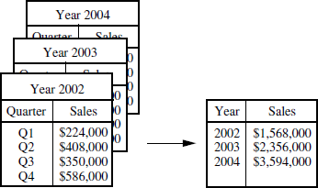
Data Cube Aggregation
If the data has sales per quarters, and we are interested in annual sales
The data can be aggregated so that the resulting data summarize the total sales per year instead of per quarter.
The resulting data set is smaller in volume, without loss of information necessary for
the analysis task.
sales per quarter are aggregated to provide the annual sales.

Slide 47
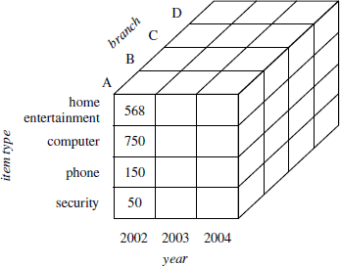
Data Cube Aggregation
Data cubes store multidimensional aggregated information.
Data cubes provide fast access to precomputed, summarized data, thereby benefiting on-line analytical processing as well as data mining.
The following data cube for multidimensional analysis of sales data with respect to
annual sales per item type.
– Each cell holds an aggregate data value, corresponding to the data point in multidimensional space.
The cube created at the lowest abstraction level is referred to as the base cuboid.
Correspond to an individual entity of interest such as sales or customer.
In other words, the lowest level should be usable, or useful for the analysis.
A cube at the highest level of abstraction is the apex cuboid.
The apex cuboid would give one total—the total sales for all three years, for all item
types, and for all branches.
Data cubes created for varying levels of abstraction are often referred to as cuboids
A data cube may instead refer to a lattice of cuboids.
Each higher abstraction level further reduces the resulting data size.

Slide 48
Attribute Subset Selection
Data sets for analysis may contain hundreds of attributes, many of which may be
irrelevant to the mining task or redundant.
Redundant Attributes duplicate much or all of the information contained in one or more other attributes.
Eg: Customer Age and Date of Birth: Both attributes provide information about the age of the customer.
Irrelevant Attributes contain almost no useful information for the data mining task.
Students' IDs are irrelevant to predict students' grade.
Attribute Subset Selection reduces the data set size by removing irrelevant or
redundant attribute.
Goal - to find a minimum set of attributes such that the resulting probability distribution of the data classes is as close as possible to the original distribution obtained using all attributes.
Attribute subset selection reduces the number of attributes appearing in the discovered patterns, helping to make the patterns easier to understand.

Slide 49
Attribute Subset Selection
How can we find a ‘good’ subset of the original attributes?
There are 2^{n} possible attribute combinations of n attributes
Typical heuristic attribute selection methods used(reduce search space, typically greedy, i.e; they always make what looks to be the best choice at the time)
The “best” (and “worst”) attributes are typically determined using tests of statistical significance, which assume that the attributes are independent of one another.

Slide 50
Heuristic Search in Attribute Subset Selection
Stepwise forward selection:
Starts with an empty set of attributes as the reduced set.
The best of the original attributes is determined and added to the reduced set.
At each subsequent iteration or step, the best of the remaining original attributes is added to the set.
2. Stepwise backward elimination:
Starts with the full set of attributes.
At each step, it removes the worst attribute remaining in the set.
3. Combination of forward selection and backward elimination:
Combine 1 and 2
Each iteration selects the best attribute and removes the worst from among the remaining attributes.

Slide 51
Dimensionality Reduction
Heuristic Search in Attribute Subset Selection
4. Decision tree induction:
Decision tree algorithms (e.g., ID3, C4.5, and CART) were originally intended for classification.
Decision tree induction constructs a flowchart like structure(node -attribute, branch- outcome of the test, and leaf node - a class prediction)
At each node, the algorithm chooses the “best” attribute to partition the data into individual classes.
When decision tree induction is used for attribute subset selection, a tree is constructed from the given data.
All attributes that do not appear in the tree are assumed to be irrelevant.
The set of attributes appearing in the tree form the reduced subset of attributes.

Slide 52
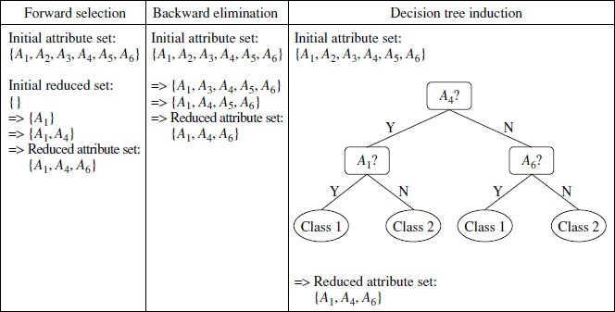
Dimensionality Reduction
Heuristic Search in Attribute Subset Selection

Slide 53
Dimensionality Reduction
In dimensionality reduction, data encoding or transformations are applied so as to obtain a reduced or “compressed” representation of the original data.
If the original data can be reconstructed from the compressed data without any loss of information, the data reduction is called lossless.
If, instead, we can reconstruct only an approximation of the original data, then the data reduction is called lossy.
Two popular and effective methods of lossy dimensionality reduction:
wavelet transforms
principal components analysis(PCA).

Slide 54
Dimensionality Reduction
Wavelet Transformation
Discrete wavelet transform is a dimension reduction technique.
The discrete wavelet transform (DWT) is a linear signal processing technique that, when applied to a n-dimensional data vector X, transforms it to a numerically different n-dimensional vector, X’, of wavelet coefficients.
Compressed approximation: store only a small fraction of the strongest of the wavelet coefficients.
All wavelet coefficients larger than some user-specified threshold can be retained.
All other coefficients are set to 0.
The resulting data representation is therefore very sparse, so that operations that can take advantage of data sparsity are computationally very fast if performed in wavelet space.

Slide 55
Dimensionality Reduction
Discrete Wavelet Transformation
The general procedure for applying a discrete wavelet transform uses a hierarchical pyramid algorithm that halves the data at each iteration, resulting in fast computational speed. The method is as follows:
1. The length, L, of the input data vector must be an integer power of 2. This condition can be met by padding the data vector with zeros as necessary (L ≥ n).
2. Each transform involves applying two functions.
The first applies some data smoothing, such as a sum or weighted average.
The second performs a weighted difference, which acts to bring out the detailed features of the data.
3. The two functions are applied to pairs of data points in X, that is, to all pairs of measurements (x2i;x2i+1). This results in two sets of data of length L=2.
In general, these represent a smoothed or low-frequency version of the input data and the high frequency content of it, respectively.
4. The two functions are recursively applied to the sets of data obtained in the previous loop, until the resulting data sets obtained are of length 2.
5. Selected values from the data sets obtained in the above iterations are designated the wavelet coefficients of the transformed data.

Slide 56
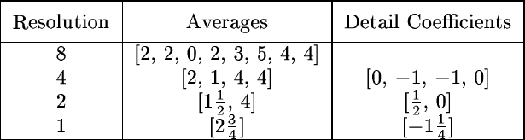
Dimensionality Reduction
Discrete Wavelet Transformation
Wavelets: A math tool for space-efficient hierarchical decomposition of functions
8-dimensional data vector S = [2, 2, 0, 2, 3, 5, 4, 4] can be transformed to 8-dimensional wavelet coefficient vector S^ = [2³/₄, -1¹/₄, ¹/₂, 0, 0, -1, -1, 0]
Compression: many small detail coefficients can be replaced by 0’s, and only the significant coefficients are retained
Notes:
https://www.youtube.com/watch?v=c1XL5BeI9_s

Slide 57
Dimensionality Reduction
Principal Component Analysis (PCA)
Suppose that the data to be reduced consist of tuples described by n dimensions.
Principal components analysis (PCA) searches for k n-dimensional orthogonal vectors that can best be used to represent data, k ≤n.
The original data are thus projected onto a much smaller space, resulting in
dimensionality reduction.
Unlike attribute subset selection, which reduces the attribute set size by retaining a subset of the initial set of attributes, PCA “combines” the essence of attributes by creating an alternative, smaller set of variables.
The initial data can then be projected onto this smaller set.
PCA often reveals relationships that were not previously suspected and thereby allows
interpretations that would not ordinarily result.

Slide 58
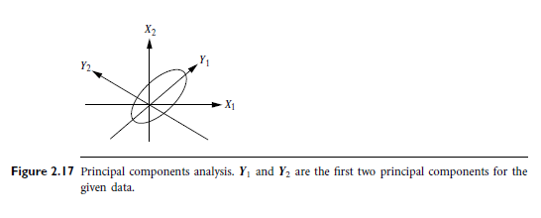
Dimensionality Reduction
Principal Component Analysis (PCA)
Principal Component Analysis Steps: Given N data vectors from n-dimensions, find k
≤ n orthogonal vectors (principal components) that can be best used to represent data.
Normalize input data: Each attribute falls within the same range
Compute k orthonormal (unit) vectors, i.e., principal components
Each input data (vector) is a linear combination of the k principal component
vectors
The principal components are sorted in order of decreasing “significance” or strength
Since the components are sorted, the size of the data can be reduced by eliminating the weak components, i.e., those with low variance (i.e., using the strongest principal components, it is possible to reconstruct a good approximation of the original data)

Slide 59
Numerosity Reduction
Sampling
“Can we reduce the data volume by choosing alternative, ‘smaller’ forms of data representation?”
Techniques of numerosity reduction can indeed be applied for this purpose.
These techniques may be parametric or nonparametric.
Parametric methods
A model is used to estimate the data, so that typically only the data parameters need to be stored, instead of the actual data. (Outliers may also be stored.)
Eg: Log-linear models - estimate discrete multidimensional probability distributions
Nonparametric methods for storing reduced representations of the data include histograms, clustering, and sampling.

Slide 60
Numerosity Reduction
Regression and Log-Linear Models
Linear regression: Data are modeled to fit a straight line
Eg. A random variable y (response variable) can be modeled as a linear function of another random variable x(predictor variable) with eq y=wx+b, w and b are regression coefficients
Often uses the least-square method to fit the line.
Multiple regression: allows a response variable Y to be modeled as a linear function of two or more predictor variables Y = b0 + b1 X1 + b2 X2
Log-linear model: approximates discrete multidimensional probability distributions
Each tuple of n dimensions can be considered as a point in a multidimensional space
Can estimate the probability of each point for a set of discretized attributes based on a smaller subset of dimensional combinations.
Notes:
The method of least squares is a parameter estimation method in regression analysis based on minimizing the sum of the squares of the residuals made in the results of each individual equation.
The most important application is in data fitting.

Slide 61
Numerosity Reduction
Histograms
Divide data into buckets
If each bucket represents only a single attribute-value/frequency pair, the buckets are called singleton buckets.
Eg. The following data are a list of prices of commonly sold items at AllElectronics.
The numbers have been sorted:
1, 1, 5, 5, 5, 5, 5,8, 8, 10, 10, 10, 10, 12, 14, 14, 14, 15, 15, 15, 15, 15, 15, 18, 18, 18, 18, 18, 18, 18, 18, 20,20, 20, 20, 20, 20, 20, 21, 21, 21, 21, 25, 25, 25, 25, 25, 28, 28, 30, 30, 30.

Slide 62
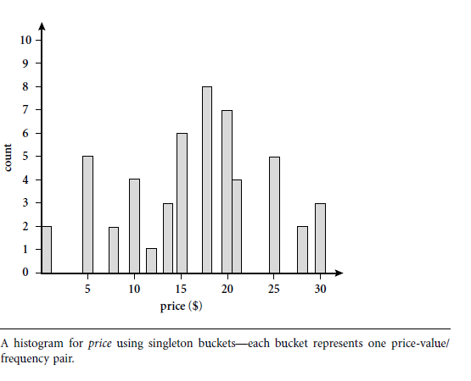

Slide 63
Histograms- Partitioning rules
Equal-width: equal bucket range
Equal-frequency (or equal-depth)
V-optimal: with the least histogram variance (weighted sum of the original values that each bucket represents, bucket weight is equal to the number of values in that bucket)
MaxDiff: Difference between each pair of adjacent values.
Set bucket boundary between each pair for pairs having the β–1 largest differences(β-user-specified number of buckets)

Slide 64
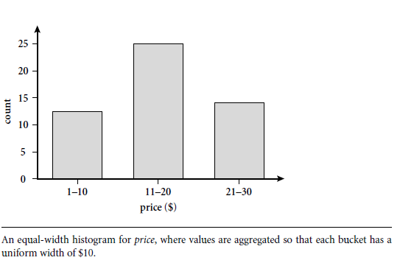

Slide 65
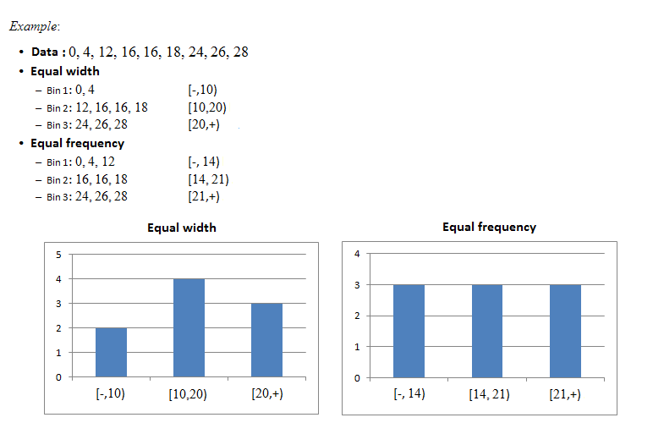

Slide 66
Numerosity Reduction
Clustering
Consider data tuples as objects.
They partition the objects into groups or clusters, so that objects within a cluster are “similar” to one another and “dissimilar” to objects in other clusters.
Similarity is commonly defined in terms of how “close” the objects are in space, based on a distance function.
The “quality” of a cluster may be represented by its diameter, the maximum distance between any two objects in the cluster.
Centroid distance is an alternative measure of cluster quality and is defined as the average distance of each cluster object from the cluster centroid.

Slide 67
Numerosity Reduction
Sampling
Sampling is the main technique employed for data selection.
It is often used for both the preliminary investigation of the data and the final data analysis.
Statisticians sample because obtaining the entire set of data of interest is too expensive or time consuming.
Sampling is used in data mining because processing the entire set of data of interest is too expensive or time consuming.
The key principle for effective sampling is the following:
using a sample will work almost as well as using the entire data sets, if the sample is
representative
A sample is representative if it has approximately the same property (of interest) as the original set of data

Slide 68
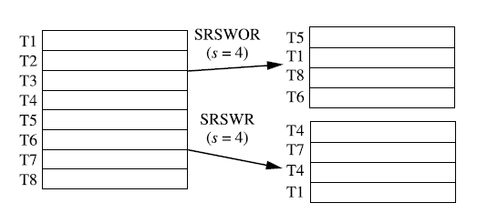
Sampling
Sampling: obtaining a small sample s to represent the whole data set N
Allow a mining algorithm to run in complexity that is potentially sub-linear to the size of the data.
Simple random sample without replacement (SRSWOR) of size s: drawing s of the N tuples from D (s < N), where the probability of drawing any tuple in D is 1/N
As each item is selected, it is removed from the population
Simple random sample with replacement (SRSWR) of size s: each time a tuple is drawn from D, it is recorded and then replaced
Objects are not removed from the population as they are selected for the sample.

Slide 69
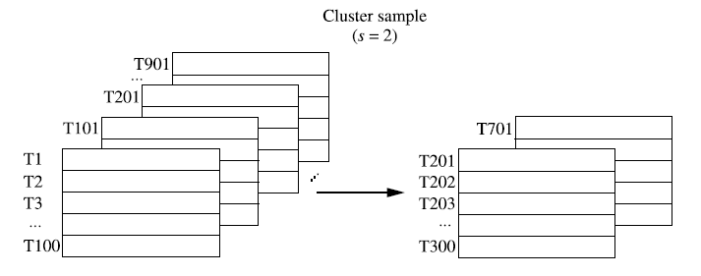
Cluster sample: Tuples in D are grouped into M mutually disjoint “clusters,” then an SRS of s clusters can be obtained, where s < M

Slide 70
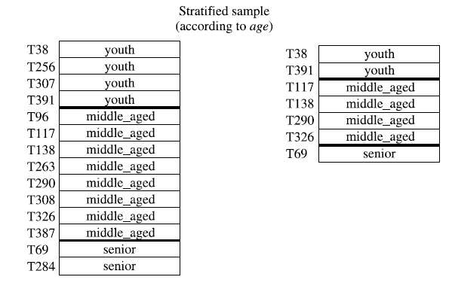
Stratified sample: If D is divided into mutually disjoint parts called strata, a stratified sample of D is generated by obtaining an SRS at each stratum.
Split the data into several partitions; then draw random samples from each partition.
In the simplest version, equal numbers of objects are drawn from each group even though the groups are of different sizes.
In an other variation, the number of objects drawn from each group is proportional to the size of that group.

Slide 71
Discretization
Discretization: To transform a numeric (continuous) attribute into a categorical attribute.
Some data mining algorithms require that data be in the form of categorical attributes.
In discretization:
The range of a continuous attribute is divided into intervals.
Then, interval labels can be used to replace actual data values to obtain a categorical attribute.
Simple Discretization Example: income attribute is discretized into a categorical attribute.
Target categories (low, medium, high).
Calculate average income: AVG.
If income> 2* AVG, new_income_value = “high”.
If income < 0.5* AVG, new_income_value = “low”.
Otherwise, new_income_value = “medium”.

Slide 72
Discretization Methods
A basic distinction between discretization methods for classification is whether class
information is used (supervised) or not (unsupervised).
Some of discretization methods are as follows:
Unsupervised Discretization: If class information is not used, then relatively simple approaches are common.
Binning
Clustering analysis
Supervised Discretization:
Classification (e.g., decision tree analysis)
Correlation (e.g., χ² ) analysis

Slide 73
Discretization by Binning
Attribute values can be discretized by applying equal-width or equal-frequency
binning.
Binning aproaches sorts the atribute values first, then partition them into the bins.
equal width approach divides the range of the attribute into a user-specified number of intervals each having the same width.
equal frequency (equal depth) approach tries to put the same number of objects into each interval.
After bins are determined, all values are replaced by bin labels to discretize that
attribute.
– Instead of bin labels, values may be replaced by bin means (or medians).
Binning does not use class information and is therefore an unsupervised discretization technique.

Slide 74
Discretization by Binning: Example
equal-width approach
Suppose a group of 12 values of price attribute has been sorted as follows:
price | 5 | 10 | 11 | 13 | 15 | 35 | 50 | 55 | 72 | 89 | 204 | 215
equal-width partitioning: The width of each interval is (215-5)/3 = 70.
Partition them into three bins
bin1 | 5, 10, 11, 13, 15, 35, 50, 55, 72
bin2 | 89
bin3 | 204, 215
Replace each value with its bin label to discretize.
price | 5 | 10 | 11 | 13 | 15 | 35 | 50 | 55 | 72 | 89 | 204 | 215
categorical attr. | 1 | 1 | 1 | 1 | 1 | 1 | 1 | 1 | 1 | 2 | 3 | 3

Slide 75
Discretization by Binning: Example
equal-frequency approach
Suppose a group of 12 values of price attribute has been sorted as follows:
price | 5 | 10 | 11 | 13 | 15 | 35 | 50 | 55 | 72 | 89 | 204 | 215
equal-frequency partitioning:
Partition them into three bins: each interval contains 4 values
bin1 | 5, 10, 11, 13
bin2 | 15, 35, 50, 55
bin3 | 72, 89, 204, 215
Replace each value with its bin label to discretize.
price | 5 | 10 | 11 | 13 | 15 | 35 | 50 | 55 | 72 | 89 | 204 | 215
categorical attr. | 1 | 1 | 1 | 1 | 2 | 2 | 2 | 2 | 3 | 3 | 3 | 3

Slide 76
Discretization by Clustering
A clustering algorithm can be applied to discretize a numeric attribute.
The values of the attribute are partitioned into clusters by a clustering algorithm.
Each value in a cluster is replaced by the label of that cluster to discretize.
Clustering takes the distribution and closeness of attribute values into consideration, and therefore is able to produce high-quality discretization results.
Simple clustering: partition data from biggest gaps.
Example: partition data along 2 biggest gaps into three bins.
bin1 | 5, 10, 11, 13, 15
bin2 | 35, 50, 55, 72, 89
bin3 | 204, 215
– Replace each value with its bin label to discretize.
price | 5 | 10 | 11 | 13 | 15 | 35 | 50 | 55 | 72 | 89 | 204 | 215
categorical attr. | 1 | 1 | 1 | 1 | 1 | 2 | 2 | 2 | 2 | 2 | 3 | 3

Slide 77
Discretization by Classification
Techniques used for a classification algorithm such as decision tree can be applied to discretization.
Decision tree approaches to discretization are supervised, that is, they make use of class label information.
These techniques employ a top-down splitting approach for attribute values:
Class distribution information is used in the calculation and determination of split-points.
The main idea is to select split-points so that a given resulting partition contains as many tuples of the same class as possible.
Entropy is the most commonly used measure for this purpose.

Slide 78
Discretization by Correlation Analysis
Measures of correlation can be used for discretization.
ChiMerge is a χ² – based discretization method.
ChiMerge employs a bottom-up approach.
ChiMerge finds the best neighboring intervals and then merge them to form larger
intervals, recursively.
ChiMerge is supervised since it uses class information.
ChiMerge proceeds as follows:
Initially, each distinct value of a numeric attribute is considered to be one interval,
χ² tests are performed for every pair of adjacent intervals.
Adjacent intervals with the least χ² values merged together, because low χ² values for a pair indicate similar class distributions.
This merging process proceeds recursively until a predefined stopping criterion is met.

Slide 79
Concept Hierarchy
A concept hierarchy defines a sequence of mappings from a set of low-level concepts to higher-level, more general concepts.
Many concept hierarchies are implicit within the database schema.
Concept hierarchies may be provided manually by system users or may be automatically generated based on statistical analysis of the data distribution.
A concept hierarchy that is a total or partial order among attributes.
Concept hierarchies may also be defined by discretizing or grouping values for a given dimension.

Slide 80
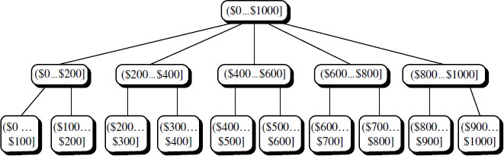
Concept Hierarchy
A concept hierarchy for the attribute price
A concept hierarchy for a numeric attribute can be constructed
automatically or it can be created by the user.
A concept hierarchy can be used for discretization.

Slide 81
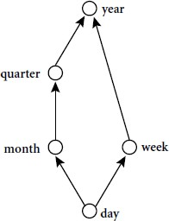
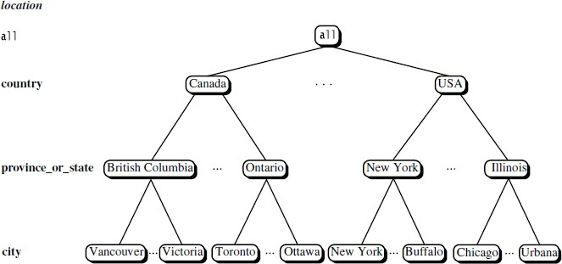
Concept Hierarchy
Concept hierarchies for nominal attributes can also be created.
time attribute
location attribute

